Slide 1


Slide 2
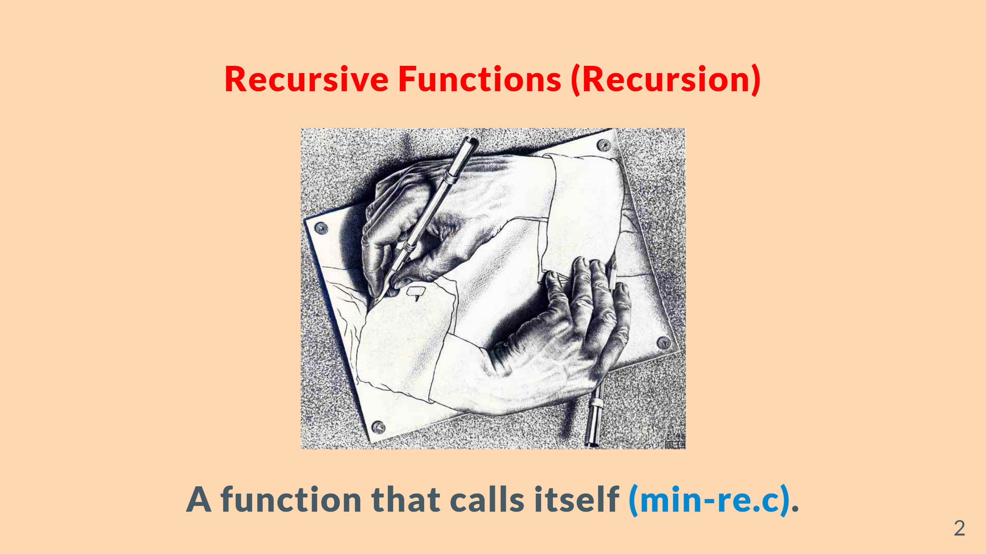

Slide 3
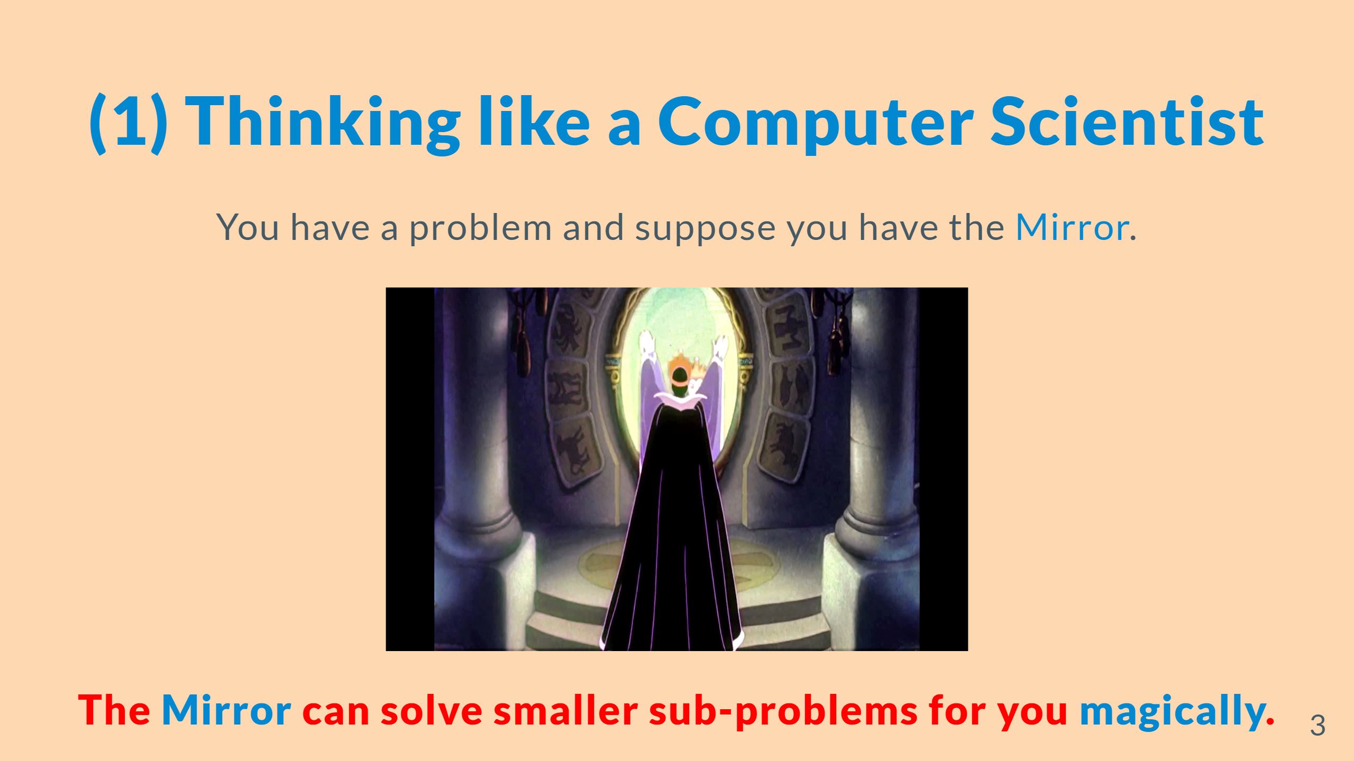

Slide 4


Slide 5


Slide 6


Slide 7
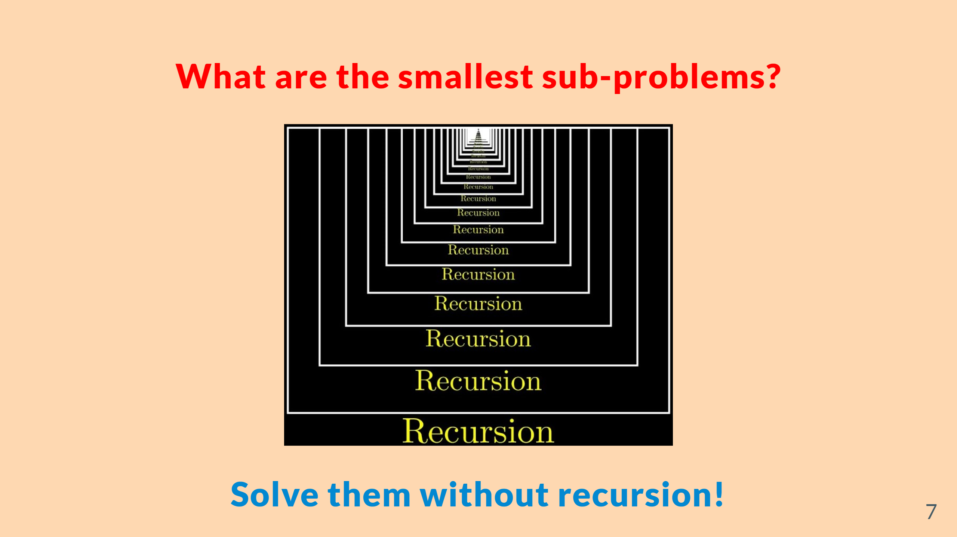

Slide 8


Slide 9
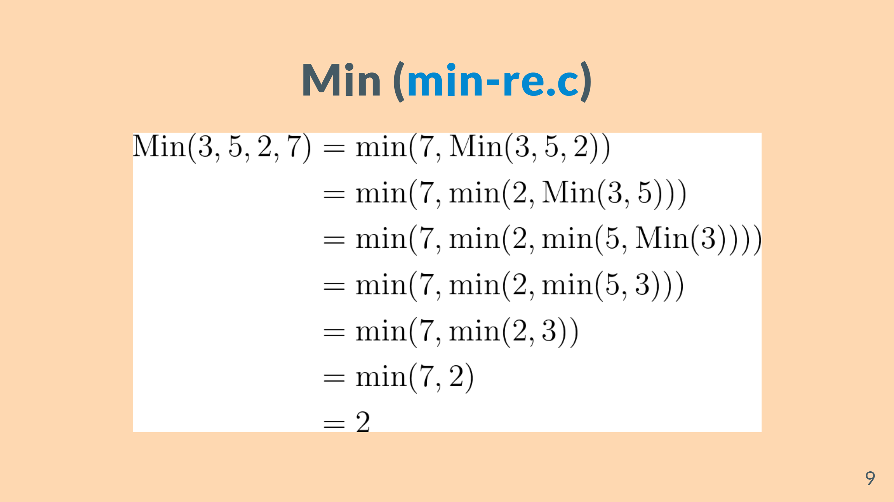
Notes:
--- # Fibonacci Sequence (<mark>fib-re.c</mark>) <br> $F_{0} = 0$ $F_{1} = 1$ $F_{n} = F_{n-1} + F_{n-2} \quad (n > 1)$

Slide 10
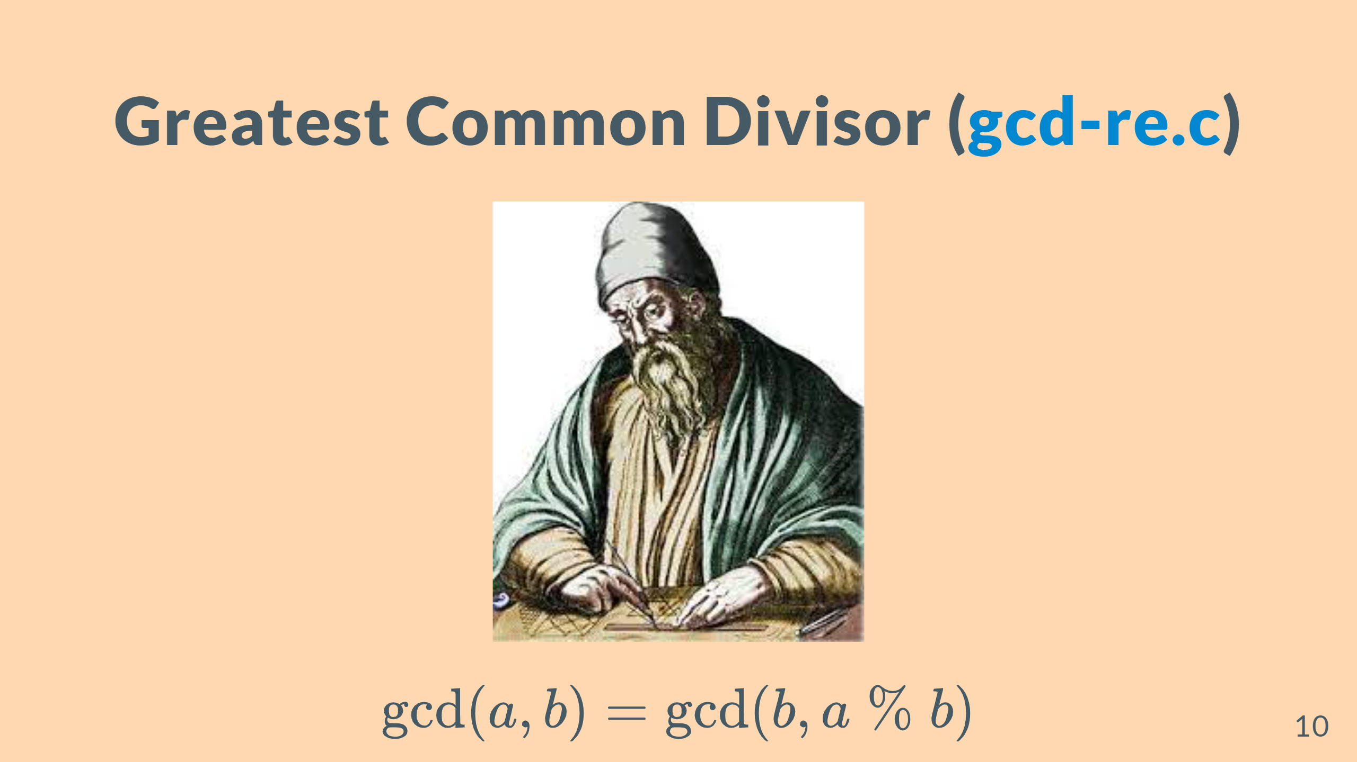

Slide 11

Notes:
You should do sth. first to obtain the smaller task.

Slide 12
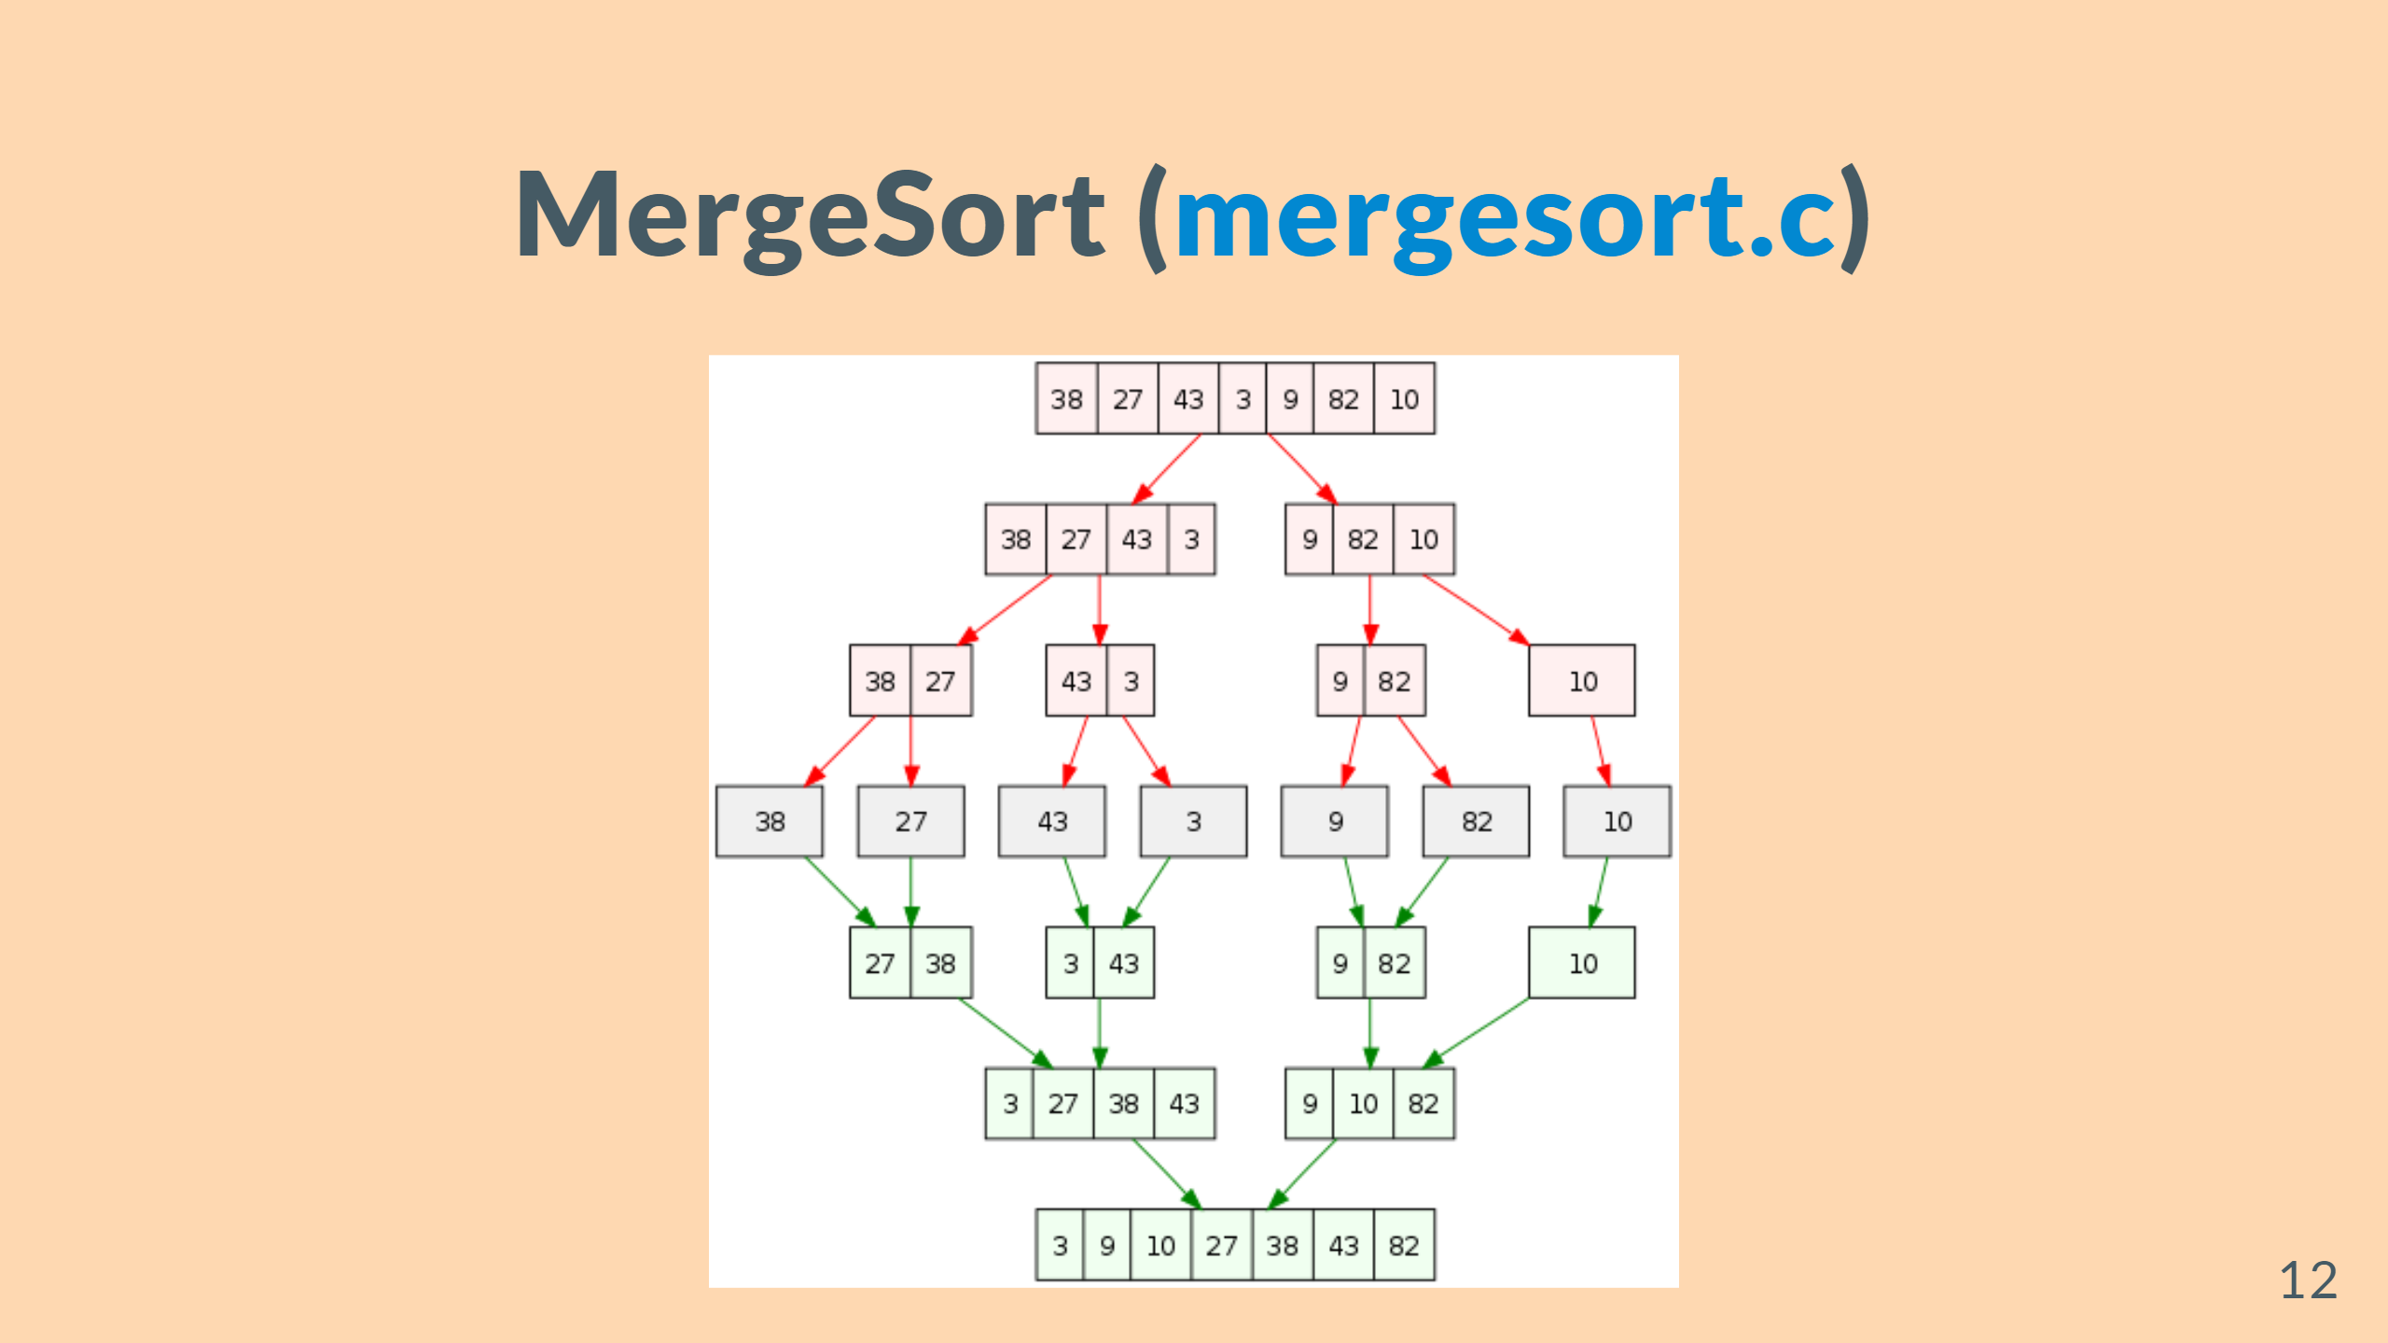

Slide 13


Slide 14


Slide 15


